Slide 1
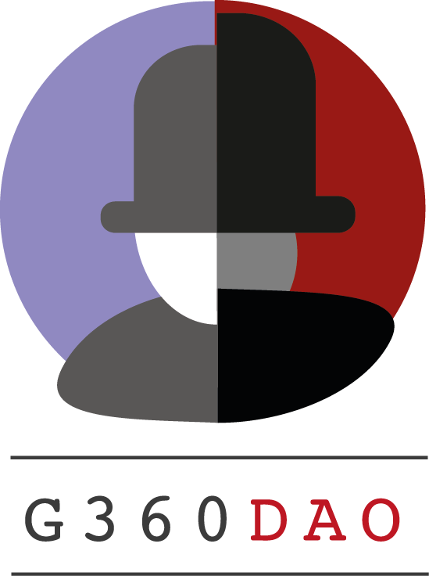

Slide 2
We thrive to increase justice on the digital infrastructure in a rebellious manner
Injustice on the internet: organizations worldwide are investing in IT and automation to improve their businesses but must deal with online criminals, ransomware, intellectual property theft and other criminal activities are interrupting business activities.
In the past year we see a rapid increase of incidents.
Instead of propagating fear, uncertainty and doubt we’re telling business owners to not be afraid.
We’re challenging solutions of so-called magic quadrant market leaders.
Suppliers of closed source tools are generating an unfair amount of revenue, while open-source developers don’t benefit from what they’re developing at all.
The same goes for security engineers and hackers. Bug bounty and coordinated vulnerability disclosure programs put them in an uncertain position because they’re depending on triage for their finding being rewarded.

Slide 3
Challenges
We have a huge information security problem at hand:
Information security incidents are on the rise despite all measures taken
Information security vendors mostly have local impact while we need global impact to make the internet more secure
Finding developers, security engineers and hackers in Europe is almost impossible
Employment of professionals from outside the EU is almost unaffordable
While employing staff from one geographical region no information security vendor is able to determine what kind of solutions businesses worldwide really need
Information security vendors are only addressing a part of the problem
A lot of talent is wasted because people are not able to participate.

Slide 4
Why a DAO?
G360DAO:
Is a global community with global impact
Will consist of developers, security engineers and hackers from all over the world
Will produce solutions businesses worldwide really need because participants are able to vote
Will increase speed of innovation because of the amount of participants
Will compete with renowned information security vendors because control is distributed and added value is rewarded fairly
Will be a separate Dutch legal entity (such as cooperative, association, t.b.d.)

Slide 5
Information security insights
G360DAO will focus on the development of the following key products:
Open-Source security insight components for Web2, including:
Scanners for vulnerabilities in networks, websites/web applications, IoT devices and other Internet connected hard- and software.
Recommendations to better comply with and deviate from norms, standards, laws, and regulations.
Report incorrectly implemented or missing hardening best practices
Detect intruders
Recommendations to prevent ransomware
Smart contract – web3 security scanners. Decentralized solutions and applications are rising quickly, creating an even larger DeFi, MetaVerse and other Web3 solution communities. Much is based on blockchain and smart contracts, which post new security problems in their own where new and innovative security solutions need to be found.

Slide 6
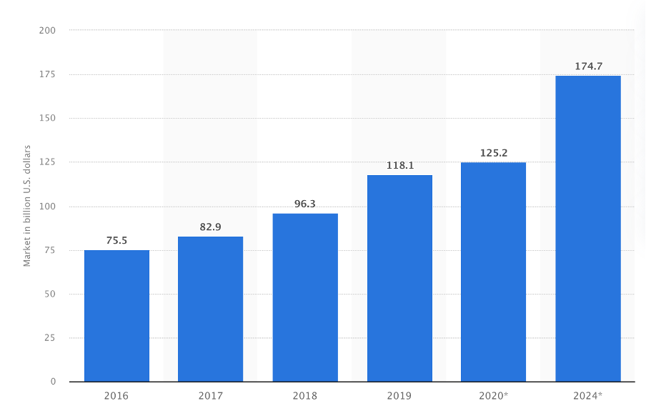
Global information security market size
By 2024, the worldwide market size for information security is expected reach almost 175 billion.
The global cyber security market was valued at USD 139.77 billion in 2021. The market is projected to grow from USD 155.83 billion in 2022 to USD 376.32 billion by 2029, exhibiting a CAGR of 13.4% during the forecast period.

Slide 7
GTM and revenue share
G360DAO will serve three types of customers:
Hackers, developers, and other experts that will use open-source code for free
Software firms and integrators that will obtain a license for source code they embed in their own products and service offering
Clients who are capable to use G360DAO information security insights themselves
We primarily aim for a recurring revenue model. In the future we might do some projects for a one-time fee but that’s not our main focus.
Revenue will be shared amongst participants of the DAO: hackers, developers, investors and all other contributors.

Slide 8
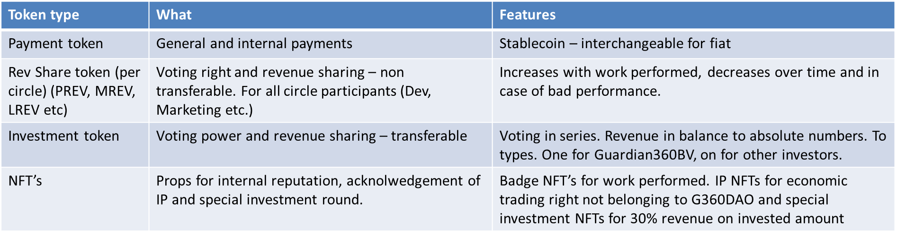
Token structure
This is an excerpt from: https://whitepaper.g360dao.io/governance-and-tokenomics/token-structure

Slide 9
Investment opportunity: NFT
10.000 NFTs
10-30% (capped) from the moment G360DAO has a positive revenue stream
No voting power
Besides an image other benefits, depending on the NFT bought, such as:
T-Shirt
Stickers
Coffee mug
Lanyard
Meet the founders
Access annual DAO meetups
Token holder name on special page
Join advisory board

Slide 10
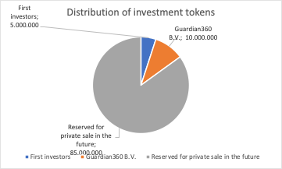
Investment opportunity: Investment tokens
100.000.000 investment tokens total
10.000.000 will be allocated to Guardian360 B.V.
5.000.000 will be sold via private sale
85.000.000 will be minted later
20-25% of the revenue stream will be assigned to investors
From the moment G360DAO has a positive revenue stream
Voting rights in investor bucket

Slide 11
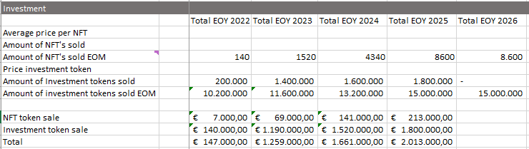
Investment opportunity: Investment tokens
Depending on when the legal entity is founded, the token sale plan looks as follows:
2022 – 200.000 tokens will be sold at 30% discount
2023 – 1.400.000 tokens at 15% discount
2024 – 1.600.000 tokens at 5% discount
2025 – 1.800.000 tokens
The nominal sales price of the token will be €1,- per token.

Slide 12
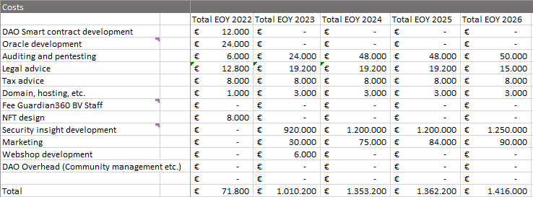
Cost structure
First years: setup DAO infrastructure, legal entity and such (+/- € 250K)
Year two and beyond: bounties for creating information security insights (+/- 100 a year) (+/- € 4,500K)

Slide 13

Expected revenue
Guardian360 B.V. will start paying monthly subscriptions for information security insights delivered in 2023 and further
G360DAO will setup a webshop to sell subscriptions to other interested parties (such as Guardian360 B.V. competitors)

Slide 14
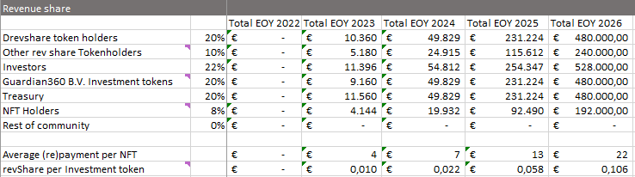
Expected revenue sharing
Token holders will be granted revenue share (not profit)
Various groups:
Direct contributors of the DAO (RevShare)
Regular investors (infinite)
NFT investors (capped)
Guardian360 (only webshop sales)
Treasury

Slide 15
Competition and why G360DAO will succeed
Competition includes listed organizations, SME companies as well as open-source projects from all over the world. However, we haven’t seen a community like G360DAO so far.
The three dominant reasons why we believe G360DAO will succeed:
Solutions that strengthen resilience of organizations worldwide
Community driven, leveraging on the wisdom of the crowd will result in real information security solutions
Hackers, developers, and other talented individuals from all over the world are eligible to participate without any hurdles

Slide 16
Marketing
During the first year we focus on growth of the community by contacting blockchain/web3 minded hackers, developers and other specialists:
Via Discord, Reddit, Twitter, LinkedIn, Mirror.xyz and such
Organizing events like G360DAO gatherings, meetups, virtual community event during the Dutch Blockchain Week and other events
Present G360DAO at hacker spaces and conferences
Tap into existing networks and DAOs, like Guthub and Developer DAO
Online marketing

Slide 17
Team
We aim to create a community of tens of thousands of experts.
Currently the core team now exists of:
Jan Martijn Broekhof MBA, tech entrepreneur since 2001, founder of Guardian360 B.V., co-founder of Cyberveilig Nederland and chairman of VNO-NCW Provincie Utrecht
Ludo Baauw, tech entrepreneur since 1996, founder of Intermax, founder of the Intermax Group, founder of Stichting NBIP
Olivier Rikken, PhD Candidate, Blockchain and DAO governance TU Delft, Blockchain, Smart Contract, DAO & Governance Expert - International Keynote Speaker
Martin Hugo, UX Engineer, artist, NFT creator, writer
One anonymous hacker

Slide 18
Get in touch!
Official G360DAO websites, news outlets and collaboration environments:
G360DAO Website: https://g360dao.io and https://g360dao.eth
G360DAO Whitepaper: https://whitepaper.g360dao.io
Discord: https://discord.gg/Gt8P9AdQTM
Telegram: https://t.me/+9a3WS0ArD6g0NmRl
GitHub: https://github.com/G360DAO
Mirror: https://mirror.xyz/g360dao.eth
Reddit: https://reddit.com/r/G360DAO
Twitter: https://twitter.com/G360DAO
LinkedIn: https://linkedin.com/company/g360dao

